Slide 1
DUAL North America
Overview
February 3, 2025

Slide 2
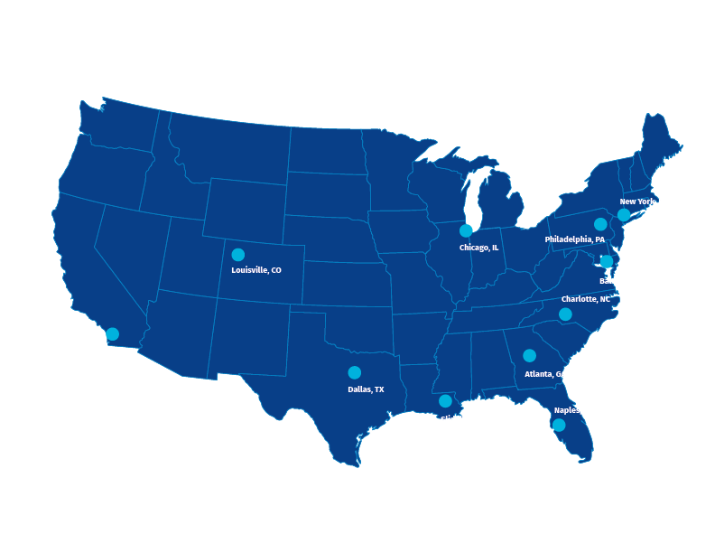
DUAL North America At a glance
DUAL North America is a leading specialty program manager in the United States, offering a wide range of insurance products underwritten through several specialized subsidiaries.
45+
Products
$1.5bn
2023 GWP
30+
Carrier partners
25
Divisions
$2.5bn
2027 GWP
600
People
With remote employees all over the U.S.
Our Subsidiaries

Slide 3
Local Experts, Global Network
Howden Group Holdings is an international insurance group with divisions in insurance and reinsurance broking, underwriting, and capital markets.
Howden Re
Howden Re, the reinsurance arm of Howden, is the premier reinsurance broker & advisor for the global market.
DUAL Group, the underwriting division of Howden Group Holdings, is one of the world’s largest international underwriting organizations and Lloyd’s largest international coverholder.
DUAL North America is the premier underwriting organization in the U.S., operating with an emphasis on expert underwriting, unique products, and unbeatable service.
North America

Slide 4
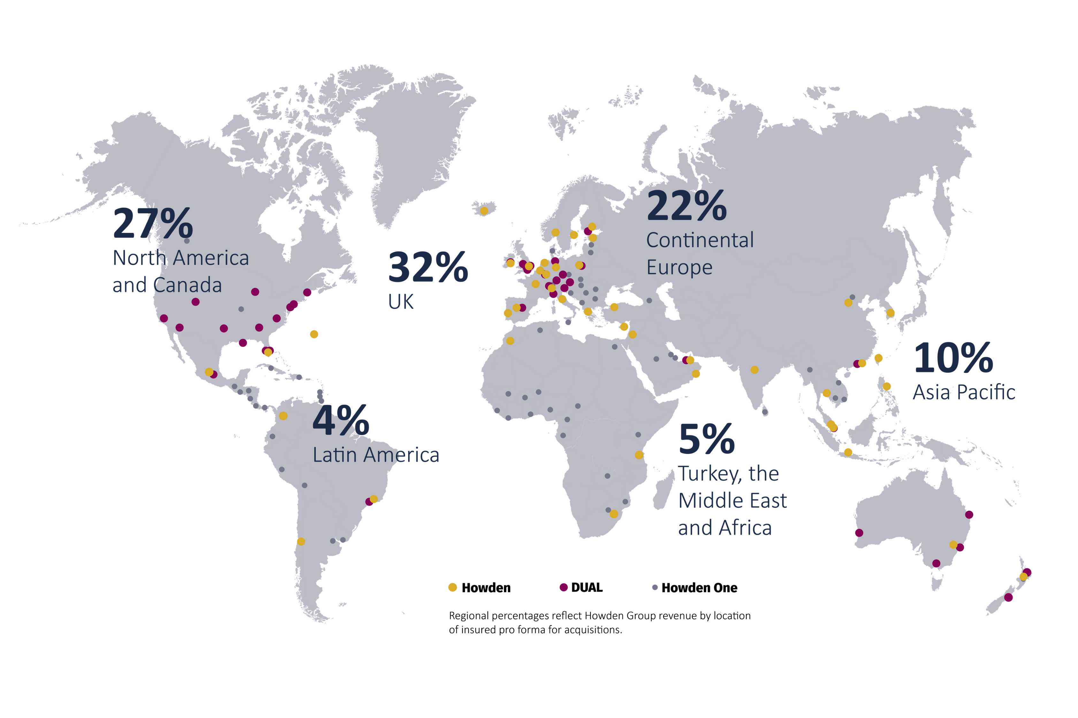
Howden Group Holdings
A unique insurance group with employee-ownership at its heart
$47bn+ GWP
16,000+ employees
50+ territories

Slide 5
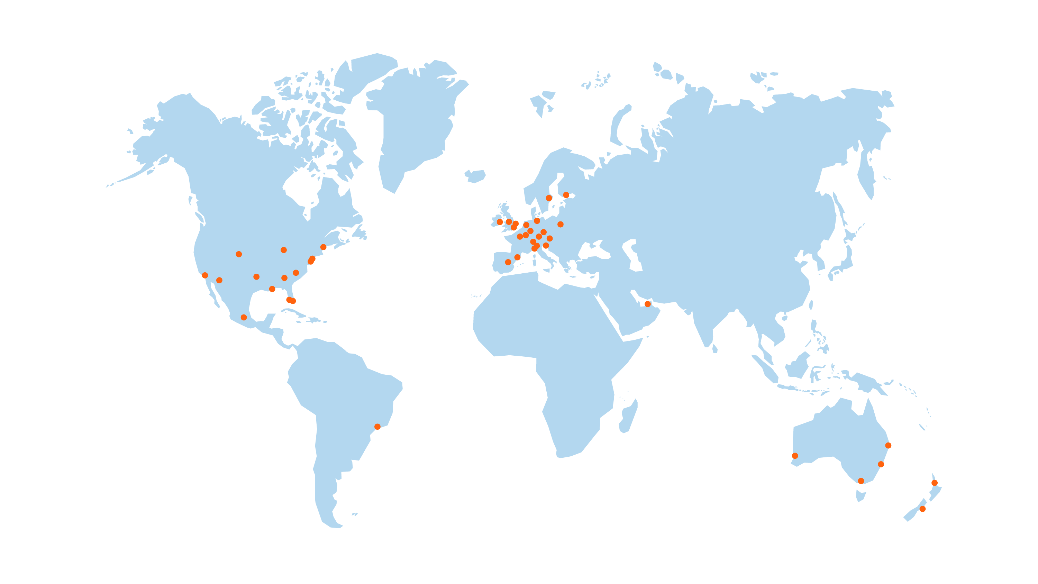
The DUAL Group
$3.5bn
2023 GWP
1,800+
people
42% ^{Americas}
32% ^{UK}
12% ^{Europe}
50 locations
11% ^{AsiaPac}
21 countries
70+ products
70+ carrier relationships

Slide 6
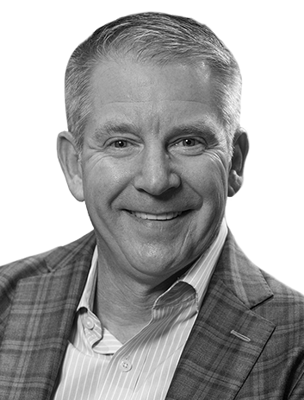
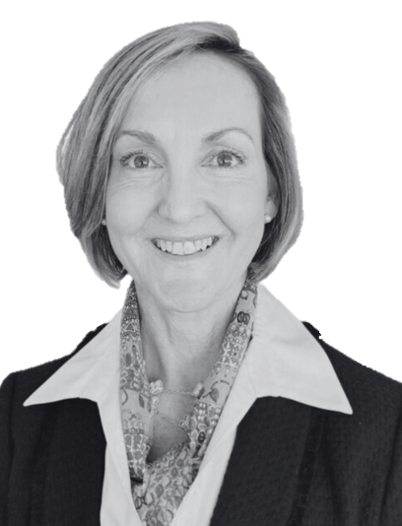
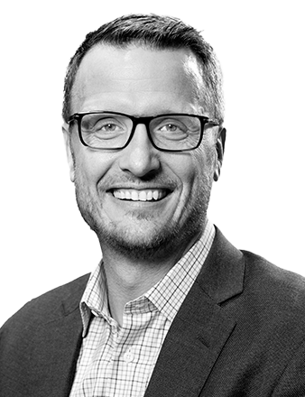
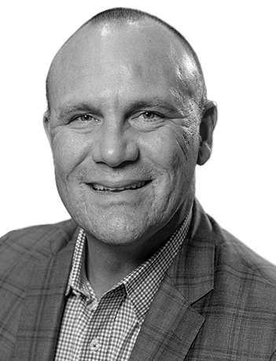
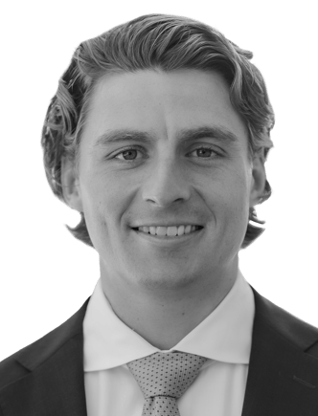
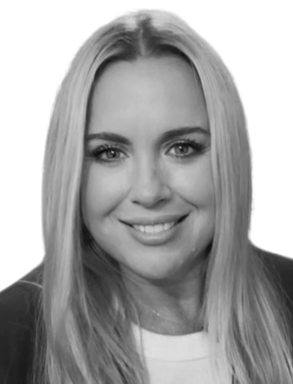
Our Leadership
John Johnson
Chief Executive Officer
With DUAL since 2021
30+ years industry experience
Connie Germano
Chief Casualty Officer
With DUAL since 2023
30+ years industry experience
Jon Knouse
Chief Property Officer
With DUAL since 2021
30+ years industry experience
Andy Swindall
Chief Personal Lines Officer
With DUAL since 2021
30+ years industry experience
Luke Wolmer
Chief Actuary
With DUAL since 2022
10+ years industry experience
Kimberly Jenkins
Head of Strategic Planning
With DUAL since 2021
DUAL North America, Inc. confidential content

Slide 7
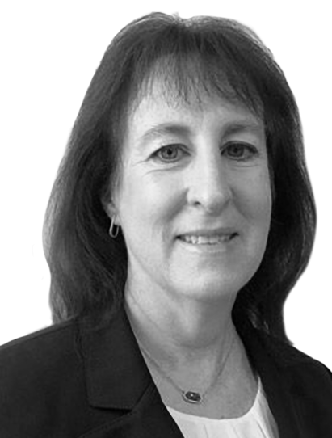
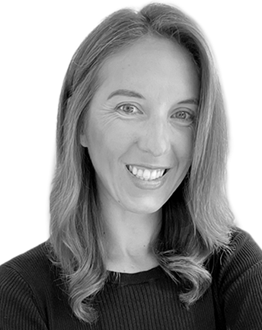
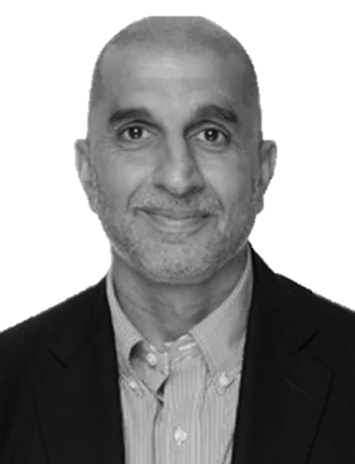
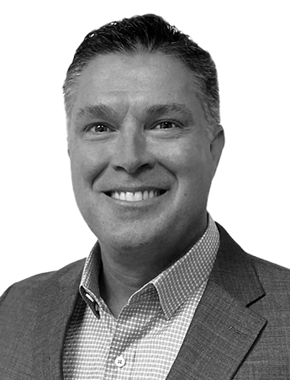
Our Leadership
John Johnson
Chief Executive Officer
Connie Germano
Chief Casualty Officer
Jon Knouse
Chief Property Officer
Andy Swindall
Chief Personal Lines Officer
Michelle Roccoforte
Chief of Staff
Luke Wolmer
Chief Actuary
Kimberly Jenkins
Head of Strategic Planning
Darren Wiltshire
Chief Financial Officer
Jerry Batcheller
Chief Operating Officer
Scott Noerr
Chief Digital Officer
Lacey Rittenour
Head of Human Resources
Ranjit Jaswal
Chief Risk Officer
Ryan O’Connor
Chief Marketing & Business Development Officer

Slide 8
Our Leadership
John Johnson
Chief Executive Officer
jjohnson@dualinsurance.com
Connie Germano
Chief Casualty Officer
cgermano@dualinsurance.com
Jon Knouse
Chief Property Officer
jknouse@dualinsurance.com
Andy Swindall
Chief Personal Lines Officer
aswindall@dualinsurance.com
Michelle Roccoforte
Chief of Staff
mroccoforte@dualinsurance.com
Luke Wolmer
Chief Actuary
lwolmer@dualinsurance.com
Kimberly Jenkins
Head of Strategic Planning
kjenkins@dualinsurance.com
Darren Wiltshire
Chief Financial Officer
dwiltshire@dualinsurance.com
Jerry Batcheller
Chief Operating Officer
jbatcheller@dualinsurance.com
Scott Noerr
Chief Information Officer
snoerr@dualinsurance.com
Lacey Rittenour
Head of Human Resources
lrittenour@dualcommerical.com
Ranjit Jaswal
Chief Risk Officer
rjaswal@dualinsurance.com
Ryan O’Connor
Chief Marketing & Business Development Officer
roconnor@dualinsurance.com

Slide 9
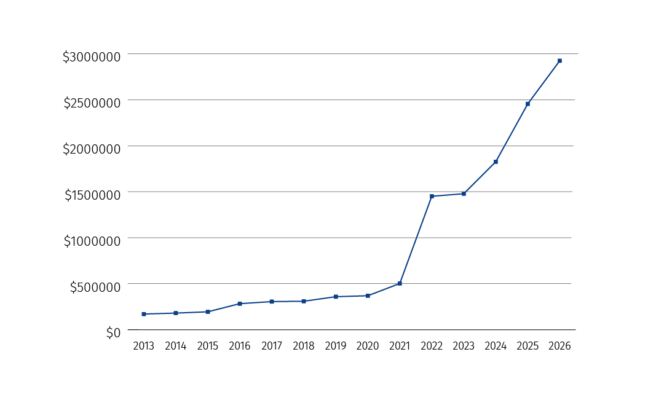
Growth & Diversification
GWP Growth
2023 GWP by Line
12%
13%
46%
29%
*all figures in USD millions
DUAL North America, Inc. confidential content

Slide 10
Our 5 strategic pillars
Profitable underwriting
Data & technology
People first
Innovation
Sustainability
Building a sustainable, profitable business that can nurture a healthy culture by providing growth opportunities and competitive benefits for its employees
Making the right underwriting decisions
to ensure sustainable, profitable results for our carrier partners
Creating positive change that can increase revenue, efficiency or productivity
Creating reproducible
Information and
scalable systems that provide in-depth insight into our business
Fulfilling the needs of current generations without compromising the needs of future generations

Slide 11
Our foundation is built on 3 main principles:
Who We Are
DUAL North America is one of the largest independent underwriting organizations in the U.S., built to help you do more.
Underwriting excellence
DUAL is an underwriting organization at its core, driven by expert underwriters across the nation who are empowered by our entrepreneurial culture and strategic infrastructure to deliver results
Product Diversity & Scalability
With a diverse but specialized product offering, DUAL can handle a wide variety of risks – and we’re always looking for new products and technology to help us scale
Unmatched Service
You can trust DUAL to provide top-tier service and quick turnaround times to our brokers and constant communication to our carrier partners

Slide 12
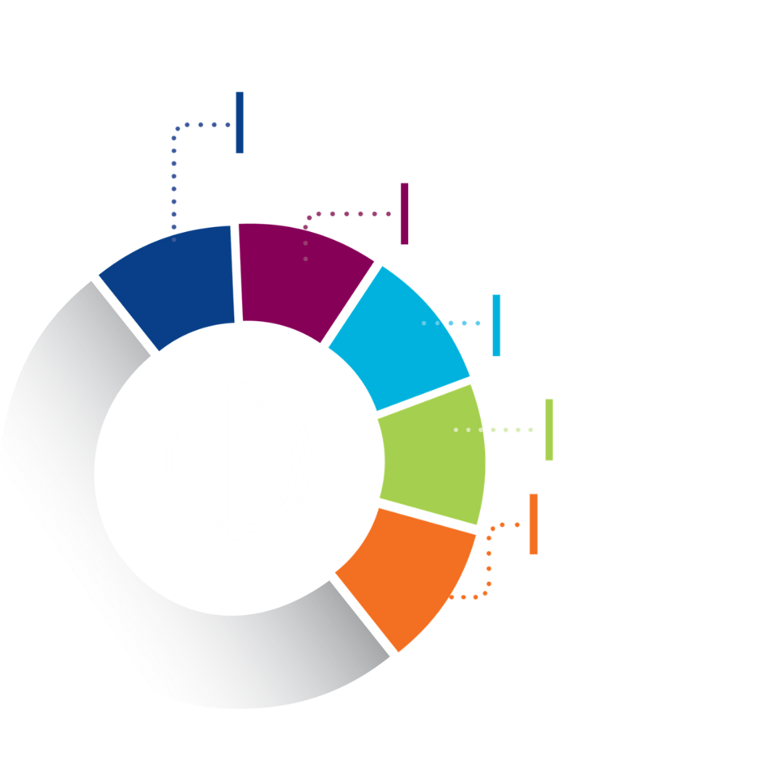
Underwriting Excellence
Underwriting integrity
Individual risk selection
At DUAL, we live, eat, and breathe underwriting - it’s who we are, not just what we do.
Our foundation is backed by expert underwriters who are driven to deliver results; we always do the right thing for our partners, never just chasing the bottom line.
Data and model driven underwriting
Actuarial support
In-house claims management
DUAL North America, Inc. confidential content

Slide 13
Preferred by brokers
DUAL is the best of both worlds for producers. We offer a large scale, diverse set of products, but we have localized service that’s focused on you. No matter where or who you are, we have your tailor-made team and array of products.
Underwriting expertise
Service-based relationships
Innovation
DUAL is an underwriting organization first, driven by expert underwriters
Trust DUAL to take care of you and your business like our own
Powered by market-leading technology for sustainable growth
Product expansion
Promptness
Access to coverage
DUAL is always seeking groups to add to our large array of diverse products
Quick turnaround times, alongside prompt, personalized service
With specialized products and many difficult to place risks, we write it all

Slide 14
Trusted by carriers
DUAL helps carriers do more. Our dedicated capacity management teams leads us as stewards of your capital. As we both continue to grow, you can rest assured that we have your bottom line in mind.
Product diversity
Global insights, local service
Sustainable underwriting
Always adding products through market gap sourcing
Access to global network, trusted by local brokers nationwide
Profitable underwriting that is driven by teams of expert underwriters
Long-term partnerships
Digital innovation
Controlled tower of capacity
Strategically designed with customized outcomes for each partner
Marketing-leading technology powering sustainable growth
Managed portfolios from market of available quality risks

Slide 15
Data-driven Underwriting
Data Warehouse
One universal source of data across all DUAL North America programs and entities provides a consistent view of our business.
Power BI
DUAL’s Data team can also:
Underwriting data including performance metrics, drilled down views of program makeup, geographic reach & more available on demand in Microsoft Power BI.
Build Proprietary Software
Manage Custom Software
Create Unique APIs
Consistent Carrier Reporting
Our data team communicates and provides individualized reporting for all carrier partners on a regular basis.

Slide 16
Modeling
Model results are the currency by which catastrophe risk is managed and traded. DUAL understands this and excels at providing our partners with optimized portfolios and the data and insights needed to trade in this space.
z
Investment
Team of 14, U.S. based, 100% full-time DUAL employees, 120 years of cumulative experience
Two dedicated systems resources to build tools to increase insight and accuracy
RMS, AIR and KatRisk Models, e2Value Valuation
Instantaneous
Every new and renewal account is analyzed for its impact on every carrier portfolio before quoting
Dynamic Pricing Model considers the impact of each account on the entire portfolio EP curve
Each carrier portfolio is refreshed and analyzed every night; near real time account impact on portfolio
Integrity
Every SOV reviewed and verified by a modeler, confirmed by inspection
Secondary modifier use limited to that which can be verified and documented
Culture of “do what’s right,” not “just what works”
Insight
Real time portfolios allow for same day reporting of impacted exposure and loss estimates for catastrophe events
Detailed carrier reporting leads to greater understanding and more effective portfolio management

Slide 17
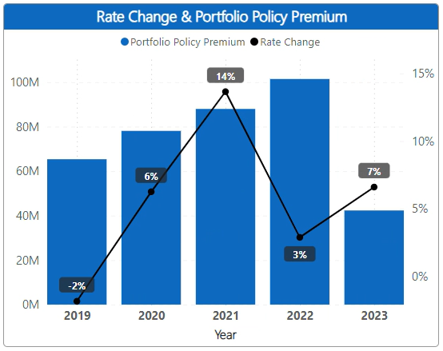
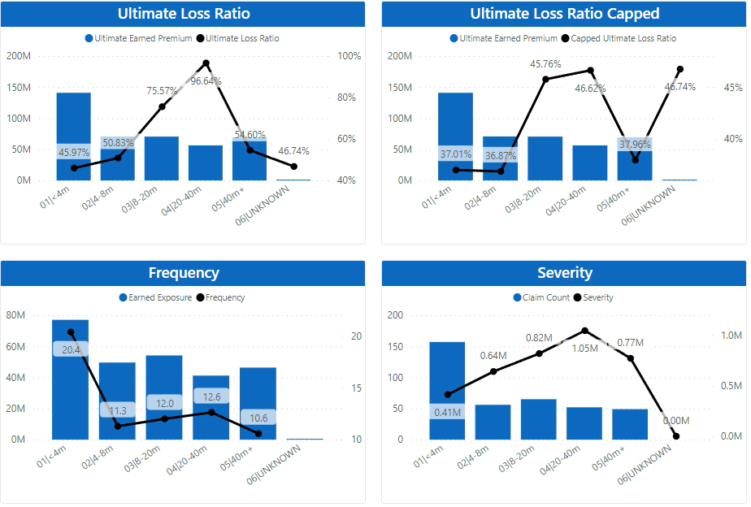
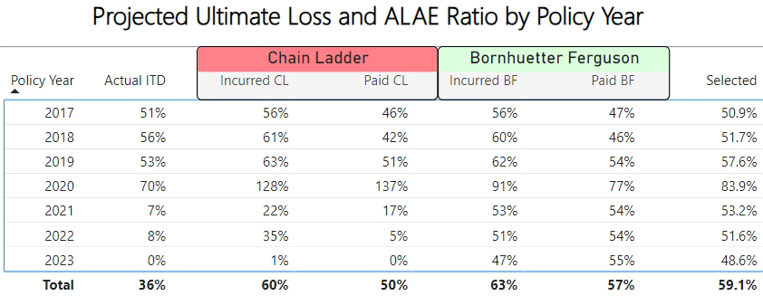
Actuarial Support
Rate Change, Trends, Development and more
Segmentation
Analysis
Quantify key actuarial assumptions such as risk adjusted rate change, loss trends and more
Evaluate core KPIs such as frequency, severity, and loss ratio to pinpoint areas for growth and opportunities for risk reduction.
Real Time
Results Monitoring
Daily updates of Ultimate Loss Ratio projections, accounting for changes in rates and trends

Slide 18
In-House Claims Management
For faster, more accurate, and cost-effective claims resolutions
20+ years
Average experience
7%
Avg claims expense savings
17,000
Claims processed annually
85
Team members
Engagement
Efficiency
Alignment
Active engagement from claim inception through resolution
Excellent communication with carriers
Continuous feedback loop from your dedicated underwriter
Proactive and efficient claims handling
Reduced handling expenses related to subscription approach
All claims handled in-house by true experts
Aligned interests of claims and underwriting
Diligence in proper assessments of claims
Preferred partner of choice for sophisticated carriers

Slide 19
Shared Risk Opportunity
As stewards of your capital, we value strategic partnership across different lines based on carrier needs. Simply put, we look after your bottom line and offer options to support your effort to create a sustainable, meaningful presence in the marketplace.
Speed to market
Seasoned underwriters
250+ years combined experience
Individual risk selection to enhance carrier profitability across market cycles
Demonstrated loss results
Reflective of validated model exposures
Best in class claims handling coupled with thoughtful underwriting
Proactive analytics
Proactive communication
Daily, monthly, and quarterly
Focused on program analysis, market conditions, and loss assessment prior to and following industry events
Risk selection
Active underwriting approach
Risks we want to write rather than risks that simply cross our underwriting desks
Scale & diversity
Long term partnerships

Slide 20
DUAL North America Products Providing bespoke solutions for specialized risks
Financial Lines
Casualty
Commercial Property
Personal Property
Architect & Engineers
Contingent Liability
Cyber
Misc. Professional
Representations & Warranties
Tax Liability
Cannabis Contamination
Commercial Auto
Concrete Pumping
Construction
Crane & Rigging
Energy Casualty
Environmental
Equipment Rental & Dealers
Excess Casualty
Heavy Transport
Inland Marine
Logistics
Ocean Marine
Product Recall
Workers’ Compensation
Builders Risk
Deductible Buyback
E&S Property
Earthquake
Bloodstock
Fine Art
Primary & Excess Flood
Terrorism/Political Violence
Wind/AOP
Dwelling
Earthquake
Flood
Limited Homeowners
Manufactured Housing
Renter’s Insurance
Healthcare
Surety
Specialty Healthcare
Misc. Facilities
Commercial Bonds
Contract Bonds
International Bonds
Tenant Lease Bonds
Notes:
Replace with updated slide

Slide 21
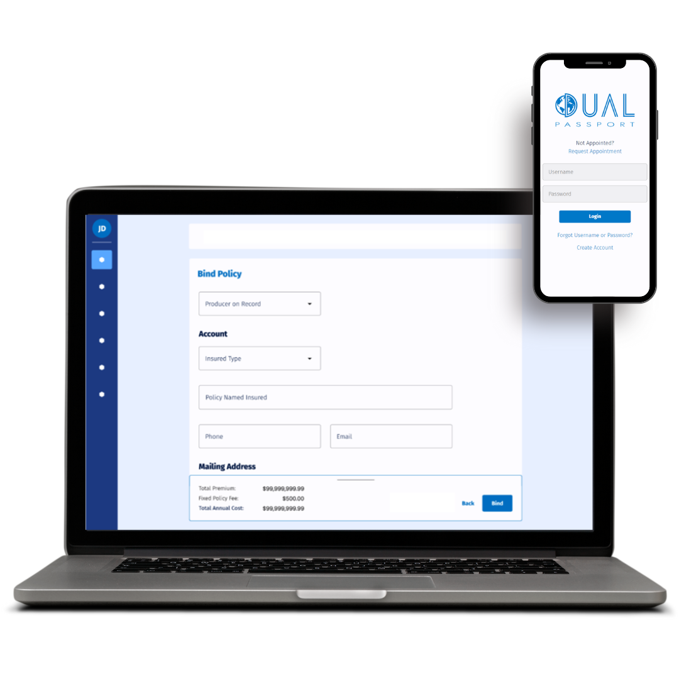
DUAL Passport
DUAL Passport is our proprietary, one-stop shop for producers across DUAL products. Right now, with DUAL Passport, Cyber producers can quote, bind, and issue policies in minutes.
By signing up for DUAL Passport, you gain access to conduct automated business backed by expert underwriters, find real time underwriting updates - and soon, you’ll be able to access performance data, update operational data, contact representatives, and more across all DUAL programs.
With DUAL Passport, you can:
Quickly and easily generate Cyber quotes
Bind and issue policies with a few clicks
Get instant access to all policy data and documentation
Get real-time underwriting updates and status alerts

Slide 22
DUAL North America
350 10th Ave. Suite 1450, San Diego, CA 92101
t +1 973 631 7575
e info@dualinsurance.com
www.dualinsurance.com
DUAL North America, Inc.

